Slide 1
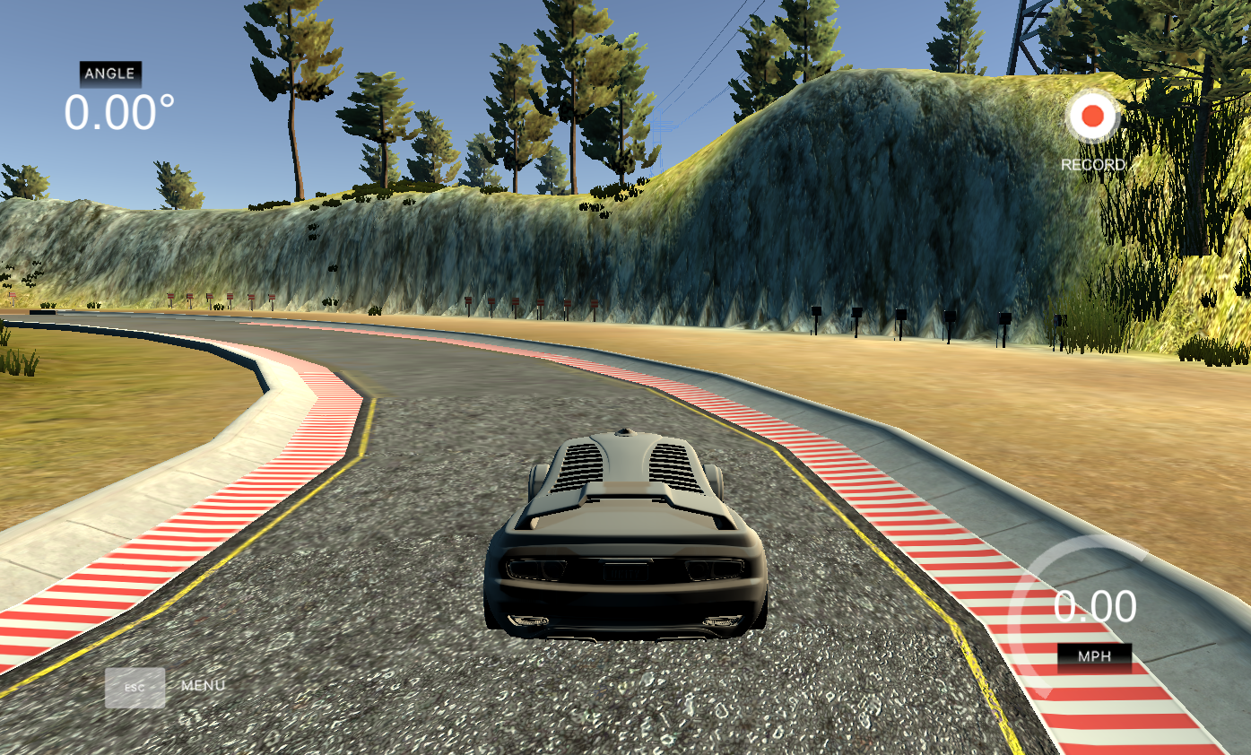
CS620 – Introduction to data science and analytics
Autonomous Vehicle Simulation Through Data-Driven Methods
Name: Varsha Natarajan
UIN: 01289709

Slide 2
Objective
To develop a predictive model to autonomously navigate a virtual vehicle in Unity using computer vision and machine learning.
Specific Aims:
1. Real-time steering predictions using visual data.
2. Address challenges in data preprocessing and feature engineering.
3. Lay the groundwork for simulation-based testing of autonomous algorithms.

Slide 3
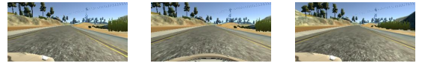
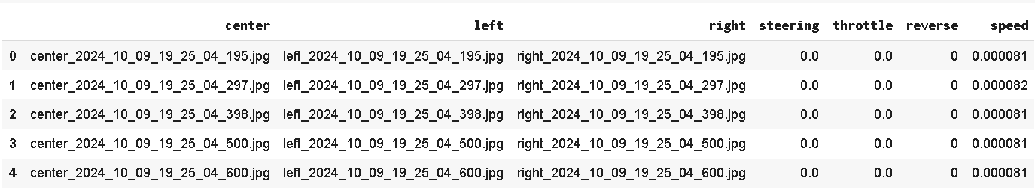
Dataset Overview
Source: Images and metadata collected from a Udacity simulator provided by Unity.
Key Components:
Three camera perspectives (left, center, right).It is stored as image files.
- CSV file with steering, throttle, reverse, and speed metadata.
Authenticity: Mimics real-world driving scenarios for robust training.

Slide 4
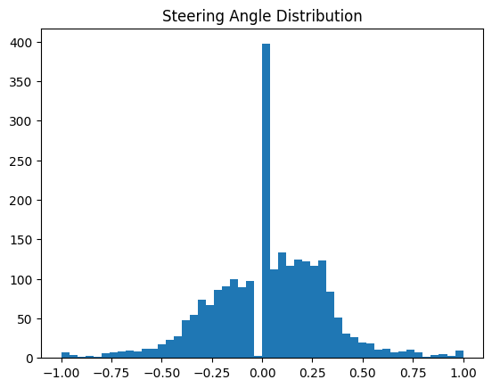
Data wrangling
Handling Missing Values: Removes null entries to ensure clean data for modeling.
Removing Duplicates: Avoids redundancy and potential model bias.
Outlier Removal: Retains realistic steering angles (-1 to 1) for accuracy.
Bin-Based Filtering: Balances data across 25 bins to reduce bias.
Visual Verification: Uses histograms to confirm balanced data distribution.

Slide 5
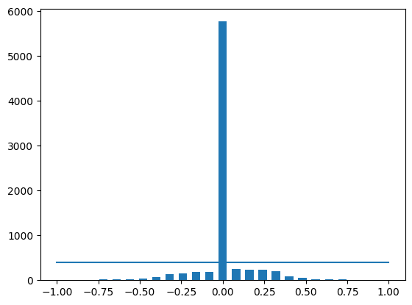
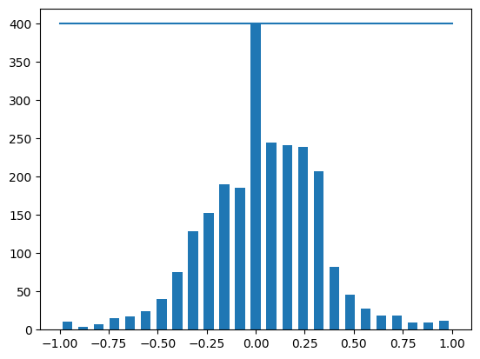
Bin based filtering

Slide 6
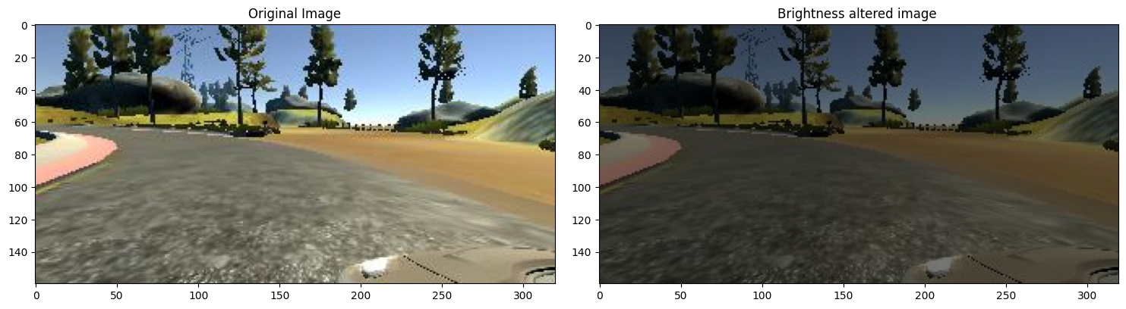
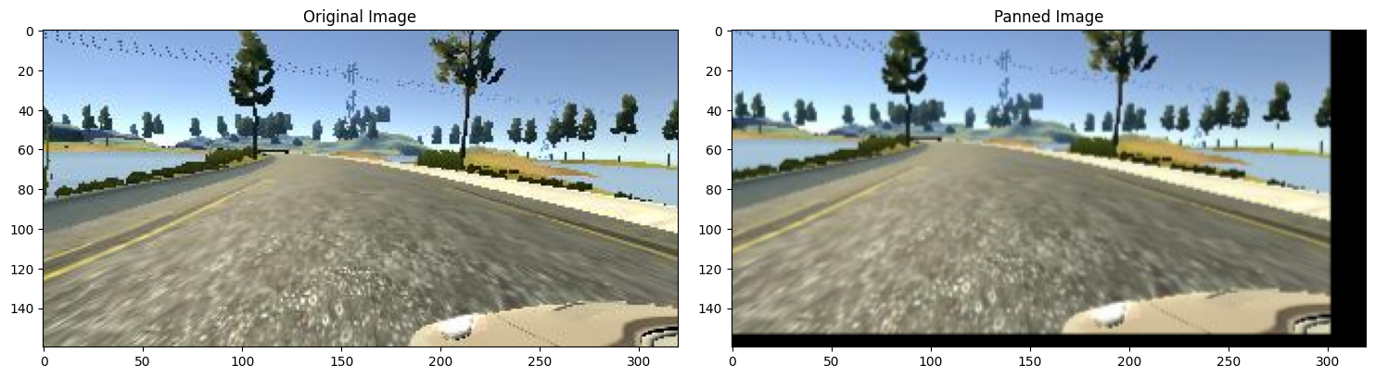
Augmentation techniques

Slide 7
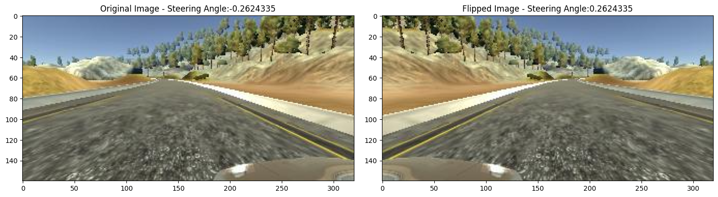
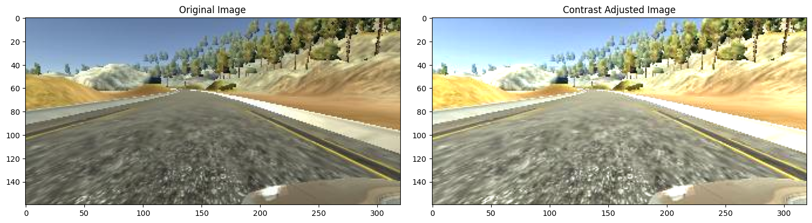
Augmentation techniques

Slide 8
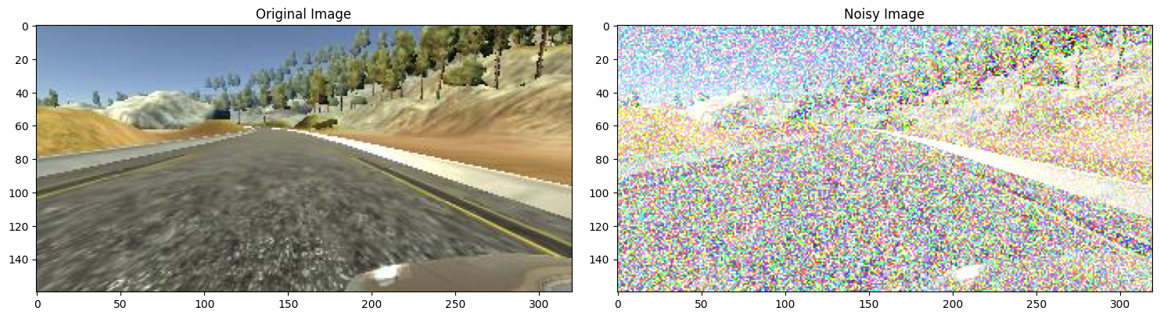
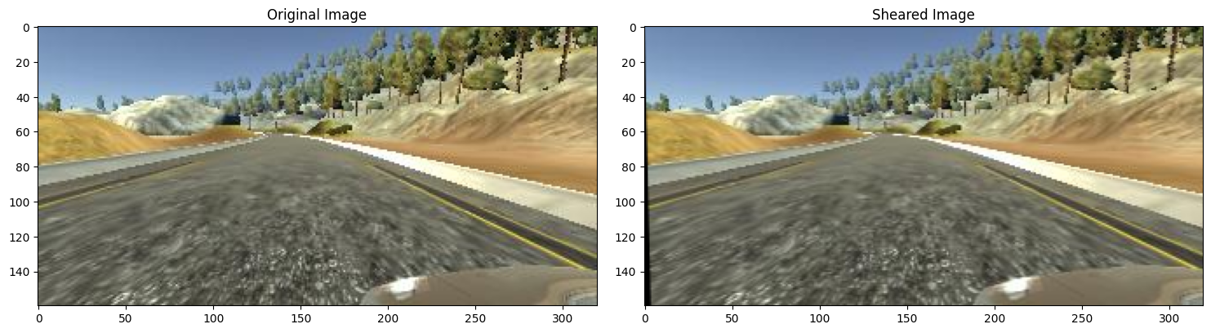
Augmentation techniques

Slide 9
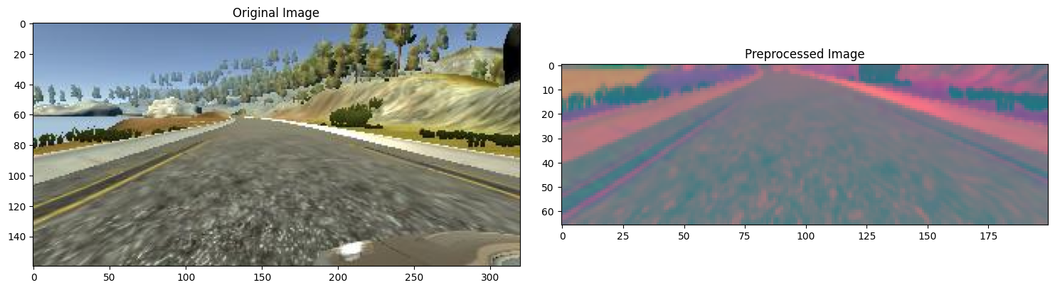
Image PREPROCESSING
Cropping: Focus on road (rows 60-135).
Color Conversion: RGB to YUV for better luminance-chrominance understanding.
Gaussian Blur: Reduces noise and enhances key features.
Resizing: Standardizes to 200x66 pixels.
Normalization: Scales pixel values to [0, 1] for efficient training.

Slide 10
Baseline and Mixed Augmentation Techniques
Baseline Techniques:
These are standard image augmentation methods designed to modify the input images to improve model generalization slightly.
Includes pan image, resizing, flipping, and brightness adjustment.
Mixed Techniques:
Advanced combinations of augmentations to simulate more complex and diverse driving scenarios.
Includes zoom with contrast adjustment, shear image, and noise injection.
Designed to enhance the model's robustness against real-world variations like lighting changes, perspective shifts, and environmental noise.

Slide 11
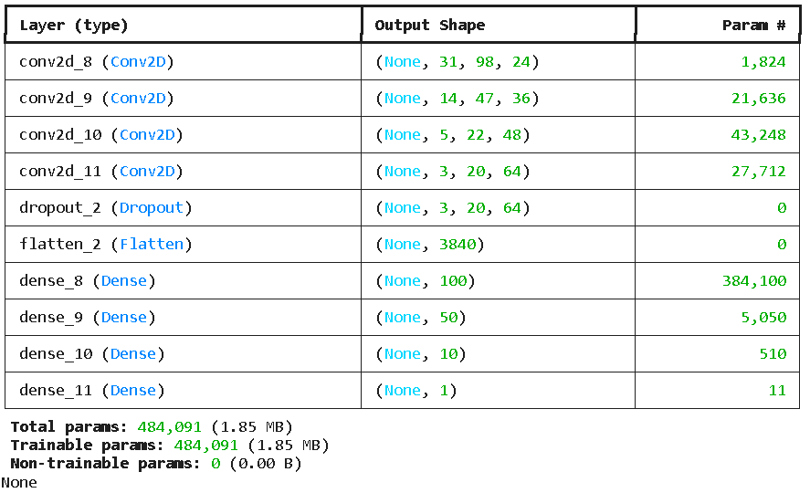
Model Architecture - Machine Learning Model
The architecture for an autonomous driving model, using machine learning algorithms that utilize convolutional and dense layers to predict steering angles is built.
The model is optimized to predict steering angles from images captured by the vehicle’s camera.

Slide 12
Evaluation metrics-Performance comparison
Metric | Baseline Model | Mixed Model
RMSE(Training) | 0.2881 | 0.2764
RMSE(Validation) | 0.2986 | 0.2450
MAE | 0.1978 | 0.1857
MSE | 0.0918 | 0.0553
R² | 0.3760 | 0.5260

Slide 13
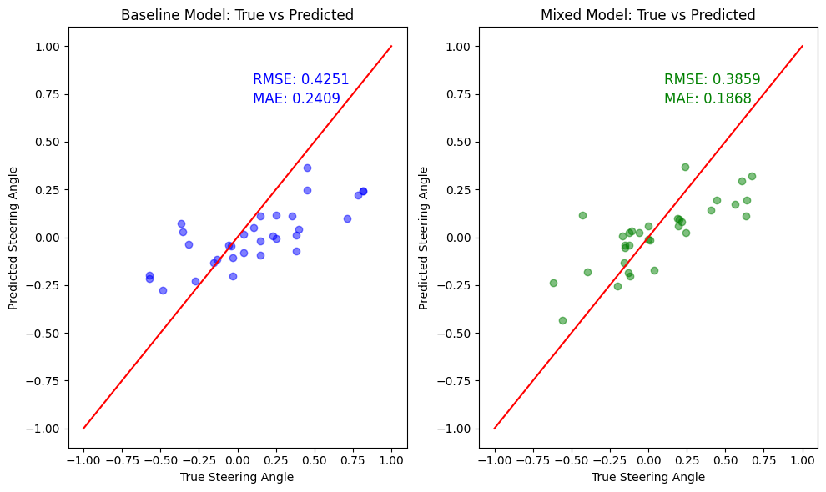
Visualization

Slide 14
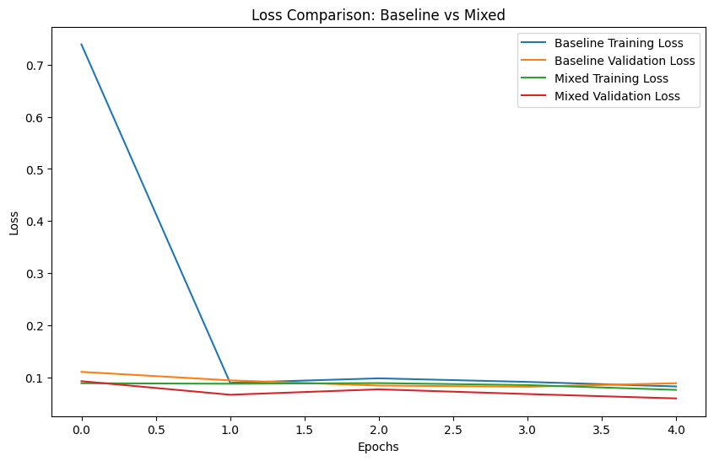
Key findings and analysis
-Mixed augmentation improved prediction accuracy significantly.
- Dataset balancing resulted in unbiased steering predictions.
- The loss values were less and simulator works perfectly.

Slide 15
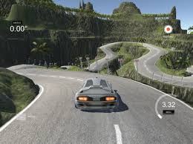
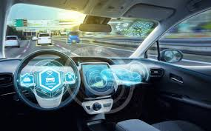
Applications
FINAL WORK
The final product is a trained predictive model capable of steering a virtual vehicle in the Unity simulator environment. It processes input images from multiple camera perspectives and predicts steering angles to navigate the simulation environment.
Autonomous driving research.
- Training environments for self-driving systems.
- Real-world deployment in delivery vehicles and driver assistance systems.

Slide 16
References
Unity Simulator:
Unity Technologies. Unity User Manual: Simulating Physics. Retrieved from https://unity.com/
Self-Driving Car Simulator:
Udacity. Self-Driving Car Simulator Repository. Retrieved from https://github.com/udacity/self-driving-car-sim
Behavioral Cloning:
Bojarski, M., et al. (2016). End to End Learning for Self-Driving Cars. Retrieved from https://arxiv.org/abs/1604.07316
Data Augmentation Techniques:
Shorten, C., & Khoshgoftaar, T. M. (2019). A survey on image data augmentation for deep learning. Journal of Big Data, 6(1), 60. Retrieved from https://journalofbigdata.springeropen.com/articles/10.1186/s40537-019-0197-0

Slide 17
Thank you
Let’s dive into how our simulator WORKS!!!

